Slide 1

PS-02 / STREAMING INTELLIGENCE
FraudShield
AI
Real-Time Fraud & Anomaly Detection System
Real-Time Algorithmic Fraud & Anomaly Detection in Streaming Data
DETECT • EXPLAIN • ADAPT
Python | FastAPI | Machine Learning | Streamlit | SQLite

Slide 2
01
The fraud window is measured in milliseconds.
Static defenses age faster than the attacks they face.
OBJECTIVE
Ingest → Analyze → Detect → Explain → Monitor → Adapt
01
02
Instant
Evolving
Fraud executes before conventional review can react.
Patterns continuously shift across users, devices and locations.
03
04
Sparse labels
Explainability
Confirmed fraud is rare, delayed and expensive to obtain.
Every alert needs a clear, actionable reason.

Slide 3
02
One platform. Continuous decisions.
API + simulator
Human reasons
FRAUDSHIELD AI
REAL-TIME RISK CORE
Behavioral features
SQLite evidence
Isolation Forest
Live dashboard
0–100 risk score
Drift + retraining

Slide 4
03
From transaction to trusted decision.
Transaction
Generator / API
Feature
Engineering
Risk
Engine
SQLite
DB
FastAPI
Backend
Isolation
Forest
Explanation
Engine
Streamlit
Dashboard
TRANSACTION → FEATURES → ML DETECTION → RISK SCORE → EXPLANATION → STORAGE → VISUALIZATION

Slide 5

04
Detect the unusual—without waiting for labels.
WHY ISOLATION FOREST
Anomalies are easier to isolate.
Random partitions separate unusual transactions in fewer steps. That makes the method ideal when confirmed fraud labels are scarce or delayed.
Fraud labels are used for evaluation—not training.
Transaction Data
Behavioral Features
Isolation Forest
Anomaly Score

Slide 6
05
15 signals build behavioral context.
TRANSACTION BEHAVIOR
LOCATION + DEVICE
TIME
Amount
Amount ratio
Amount Z-score
Transactions: last 5 min
Transactions: last 1 hour
Time since previous transaction
Distance from previous transaction
Geo-velocity
New device / merchant
Merchant frequency
Location frequency
Hour of day
Day of week
Night-time transaction
GEO DISTANCE / Haversine formula converts latitude + longitude into real-world travel distance.

Slide 7
06
A score designed for action—not ambiguity.
0—100
0–30
SAFE
APPROVED
40 pts ML anomaly + 60 pts behavioral signals
31–70
REVIEW
FLAGGED_FOR_REVIEW
Unusual amount • impossible travel • new device
unusual merchant/location • bursts • odd-hour activity
71–100
HIGH RISK
FLAGGED

Slide 8
07
Every alert answers: why?
94
Not just detection.
A defensible explanation.
HIGH RISK
DECISION / FLAGGED
Analysts get clear fraud indicators they can review, communicate and act on.
01 Statistically unusual pattern
02 Amount far above normal average
03 New device detected
04 Impossible travel velocity

Slide 9
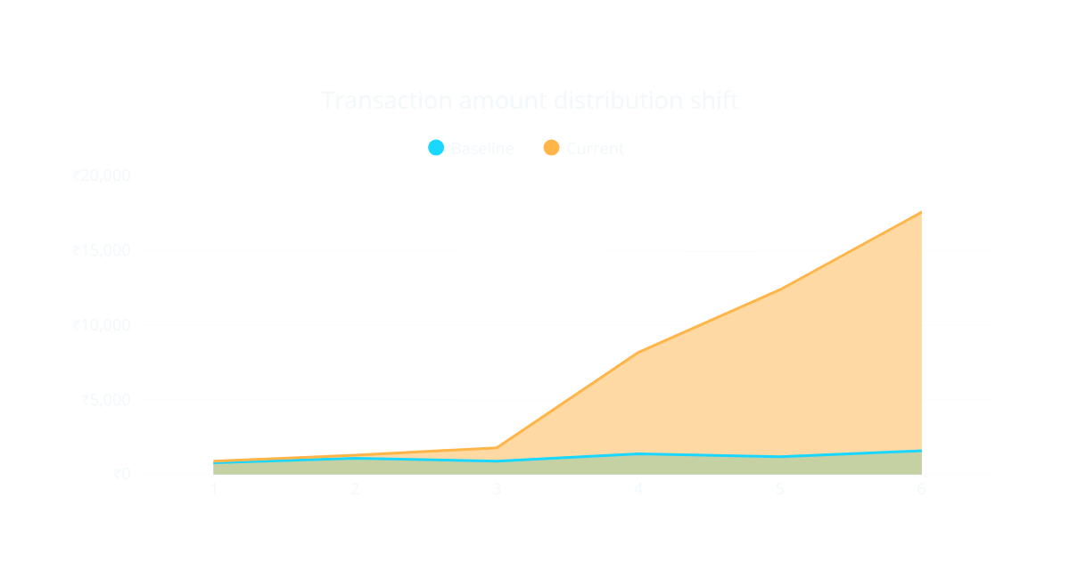
08
When behavior shifts, the model must notice.
Concept drift = a meaningful change in transaction patterns over time.
NORMAL
Similar distribution
WARNING
Moderate shift
DETECTED
Strong shift
₹500–₹2,000
₹8,000–₹20,000

Slide 10

09
Operations, live and in context.
One command center for decisions, alerts and model health.
TOTAL • SAFE • REVIEW
HIGH-RISK • AVG RISK
ANOMALY RATE
CONTROLS
Generate normal / suspicious / extreme
Simulate drift • Retrain model

Slide 11
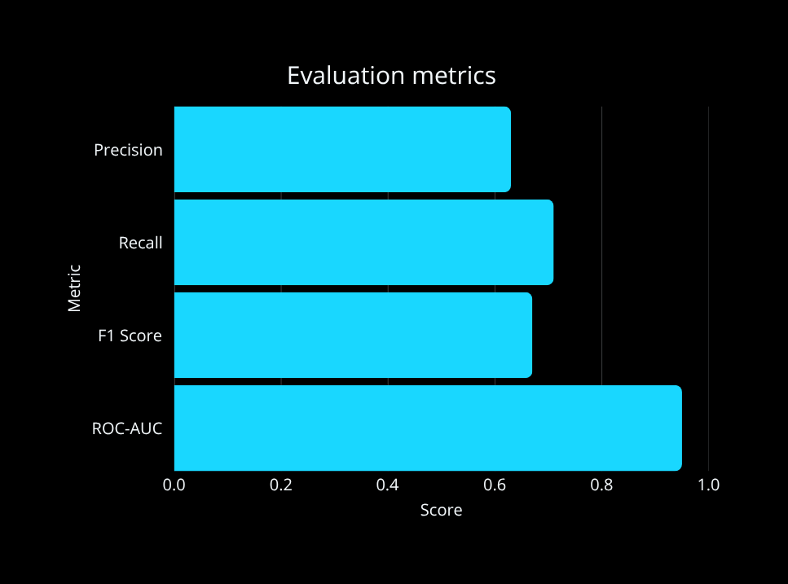
10
Robust infrastructure. Measurable performance.
Python
FastAPI + Uvicorn
Scikit-learn
Pandas + NumPy
SQLite + SQLAlchemy
Streamlit + Plotly
Joblib
Pytest
0.63 0.71 0.67 0.95
PRECISION RECALL F1 SCORE ROC-AUC

Slide 12

FUTURE SCOPE
Trust that
adapts.
Ensemble detection
Multi-feature drift
Adaptive user thresholds
Graph fraud rings
WebSocket updates
Production-scale data
REAL-TIME • EXPLAINABLE • ADAPTIVE
FraudShield AI
DETECT • EXPLAIN • ADAPT

